Slide 1
Frontend of Branding Bee
By: Anjil Shakya
Roll No. 7475/16

Slide 2
Topics Covered
Introduction
Objective
Project Scope
Use Case
Tools Used
Files
System Implementation
Screenshots

Slide 3

Organization Introduction
Branding Bee is a Digital Marketing outsourcing company, established with the aim to be the marketing partner for the associated brand.
Services:
Ecommerce Management
SEO
Lead Generation & Management
Business Development Consulting
Marketing Collateral Development

Slide 4


Project Introduction
Branding Bee Website is a website that contains the information about the organization.
Collection of webpages that contains the content regarding the specific page.
Made-up of Flexbox and Grid Layout for the optimum utilization of the workflow.

Slide 5
Objective
Lets Discuss our objectives

Slide 6
Objectives
To gain real life experience working within the organization
To develop a user friendly interface that reflects the organization
Design and develop a website as per the client’s need

Slide 7
Project Scope

Slide 8
Project Scope
Frontend development
Web Development Life Cycle
Friendly User Interface
Responsive web design

Slide 9
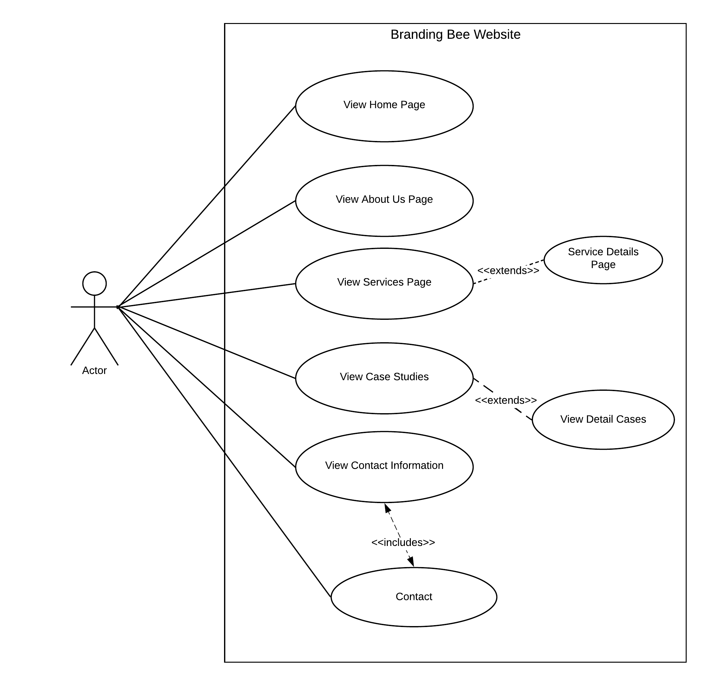
Use Case

Slide 10







Tools Used
HTML
CSS
JavaScript
Figma
Visual Studio Code
Git

Slide 11
File/Folder Structure

Slide 12
The way to get started is to quit talking and begin doing.
Walt Disney

Slide 13
System Implementation
Research
Analysis
Design
Development
Integration & Testing

Slide 14
Phases
Research
1
Analysis
2
Design
3
Development
4
Integration & Testing
5

Slide 15
Screenshots

Slide 16
Screenshots

Slide 17



Thank you
Anjil Shakya
7479/16
Website

